Slide 1
IN 1900 ( ICT Project)
Final presentation
Multifunctional Massaging Chair
Group No: 34

Slide 2





Group Members
 | Name(Write your name with Initials) | Reg. No: | Photo
Group Leader | A.K.I.Madushan | 204120D
Member 1 | K.V.Siromin | 204204N
Member 2 | K.A.P.S. Priyadarshana | 204167C
Member 3 | B.L.P. Sankalpana | 204190N
Member 4 | S.A.R. Nethmini | 204137K

Slide 3
Outline
Problem in Brief
Project aim and Objectives
Proposed Solution-System Diagram
3D Diagram
Schematic Diagram
PCB Design
3D View of PCB Design
Resources Required
Cost Estimation
Individual Contribution

Slide 4
Problem in brief
Students and people who work in offices spend most of the day sitting in a chair. Sitting in the same position for long periods of time may cause them physical discomfort.
Also, living a monotonous and busy life can lead to various mental problems in people

Slide 5
Project Aim & Objectives
Aim:
Build a Multifunctional Massaging Chair that functions automatically.
Objective:
Cool or heat the chair according to the user's necessity.
Massage the user according to his preferences( back/ foot).
Give Lumbar support to the user when the user isn't comfortable with the chair.
Make an automated footrest for the user .

Slide 6
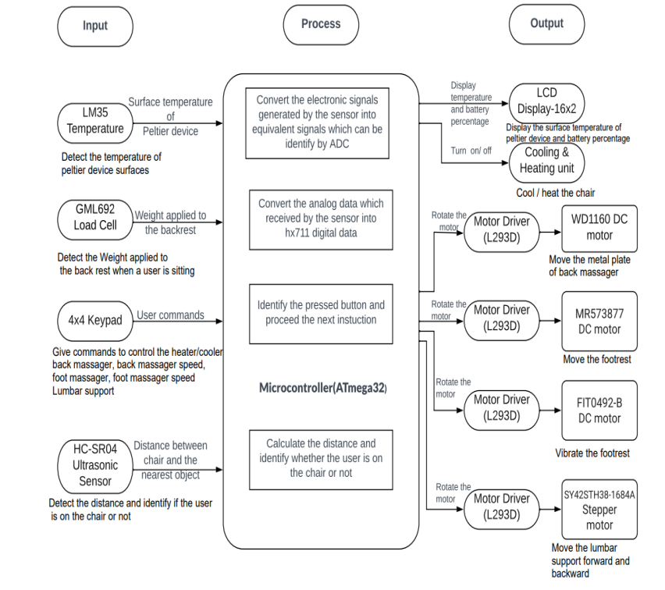
Proposed Solution-System Diagram

Slide 7
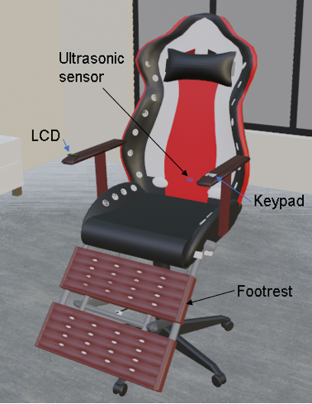
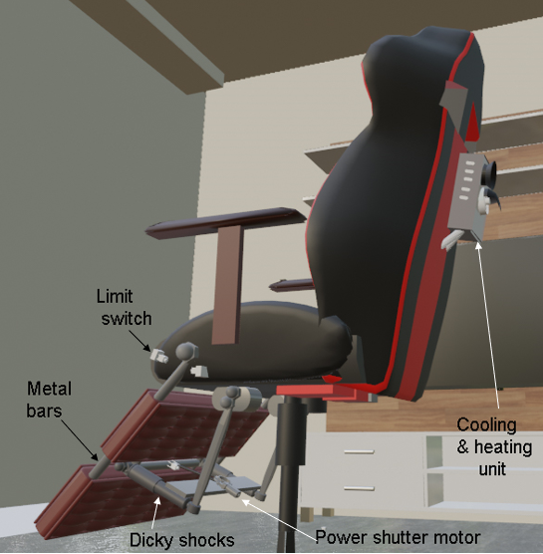
3D Diagram
3D animation link: https://dms.uom.lk/s/8sKq6FmijoANdwQ

Slide 8
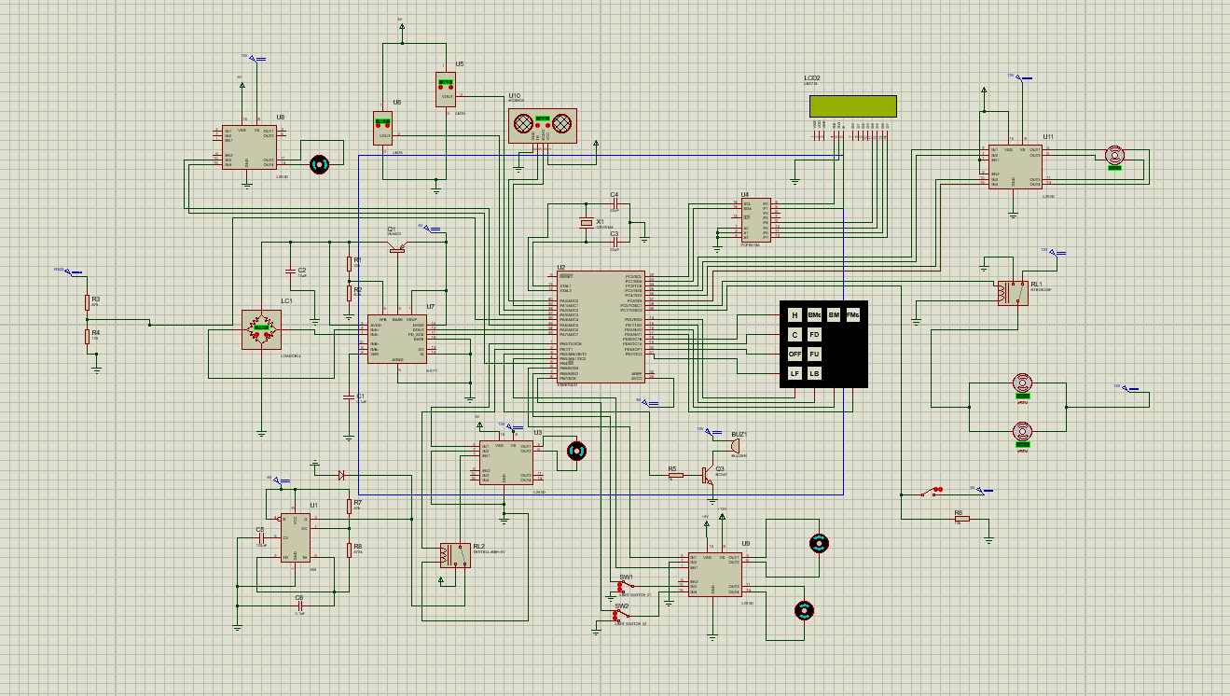
Schematic Diagram
LM 35 Temperature sensors
LCD (16x2)
Motor Driver
Ultrasonic sensor
Stepper Motor (Bipolar)
Peltier Module
Blower Fan
Load Cell
HX711
4X4 keypad
Cooling Fan
LM555 Timer
Dc motor
Relay
Motor Drive

Slide 9
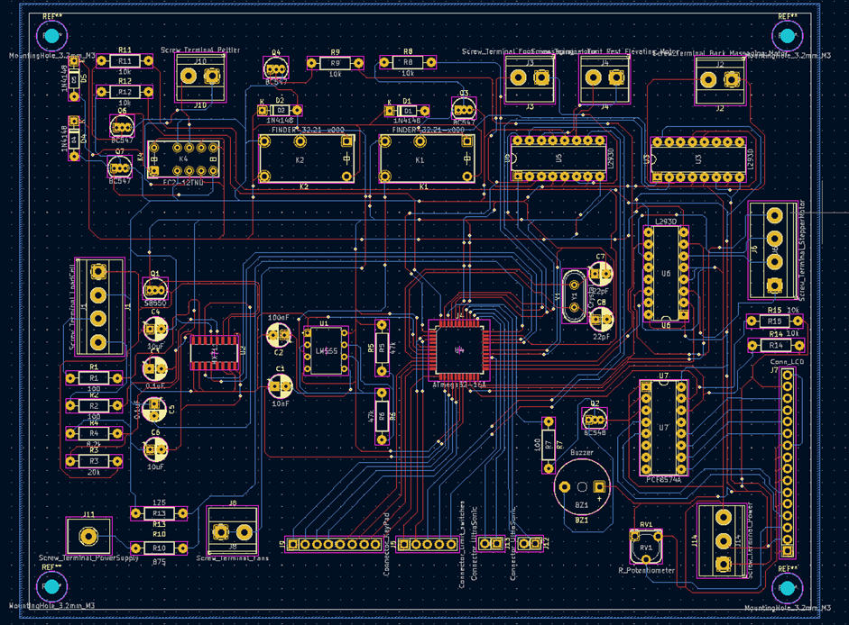
PCB Design

Slide 10
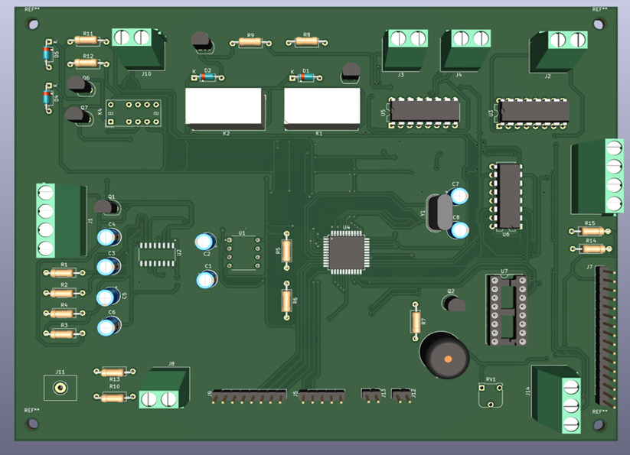
3D view of PCB Design

Slide 11
Resource Required
Softwares:
Microchip Studio,Proteus,Blender
Hardwares:
Sensors-
LM35-Temperature sensor
Load sensor
HC-SR04 Ultrasonic sensor
Microcontroller - ATmega32
Other-
DC motors Keypad
LCD Display Peltier device
PGS sheets Blowing Fan
Cooling Fan Dicky Shocks
Heatsink PCF8574A
Wooden Massage Rollers
L293D Motor drive
Stepper Motor

Slide 12
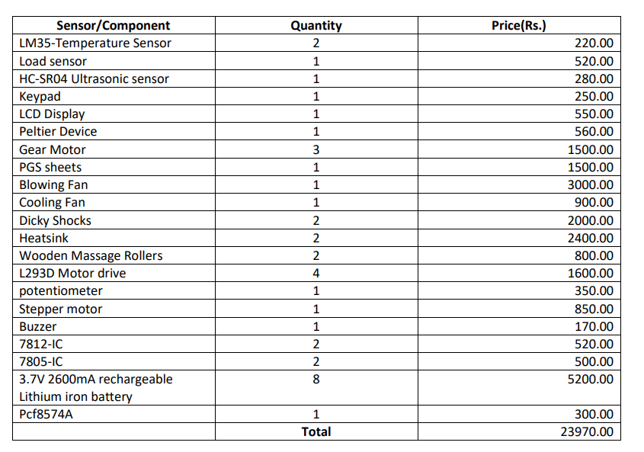
Cost Estimation

Slide 13
Individual Contribution

Slide 14
A.K.I.Madushan
Responsibilities
GML692 LoadCell- The load cell is used to determine the load which is generated by the user when he/she leans to the back rest.
HX711 - To amplify the low level voltage signals which are provided by the load cell and convert it to 24 bits binary value.
WD1160 DC motor - This gear motor is used to rotate the massaging plate for massaging the user’s back.

Slide 15
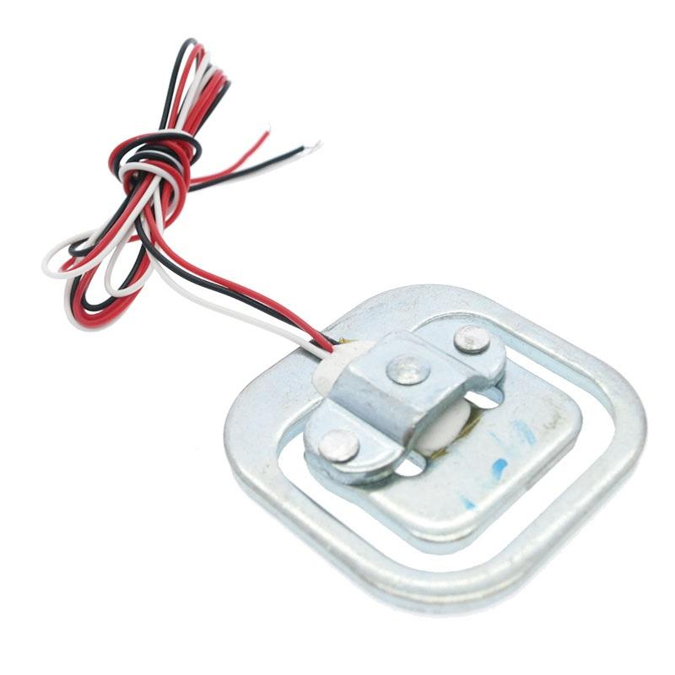
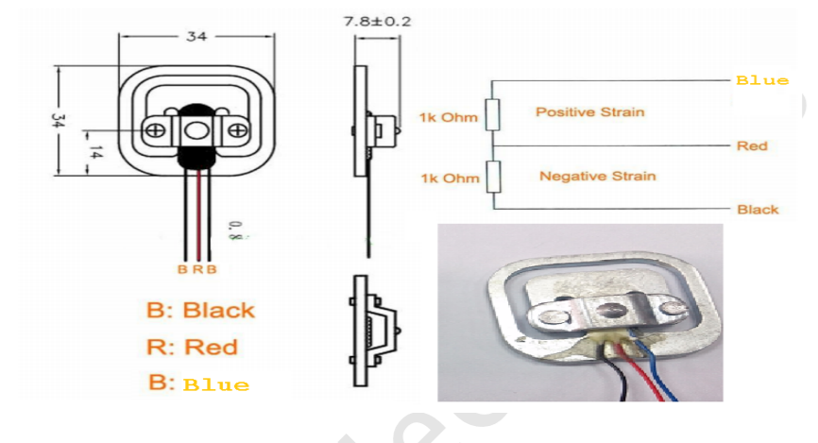
GML692 load cell

Slide 16
Technique -GML692
This load sensor is based on the Wheatstone bridge principle.
Four resistors values are there.
The resistor values change according to the weight that is placed upon the sensor.
The sensor will provide low level output voltage values(milivolts range).
Measurements are calculated by using these output voltage values.(Atmega32 ADC mechanism doesn’t have the capability of sensing this low level voltage signals)

Slide 17
Specifications-GML692 Load Cell
Maximum voltage-10V
Maximum current-Unspecified
Measuring Range(Max)-50kg
Link to refer Speciation Data Sheet- GML692 Load Cell Sensor Datasheet - Electropeak

Slide 18
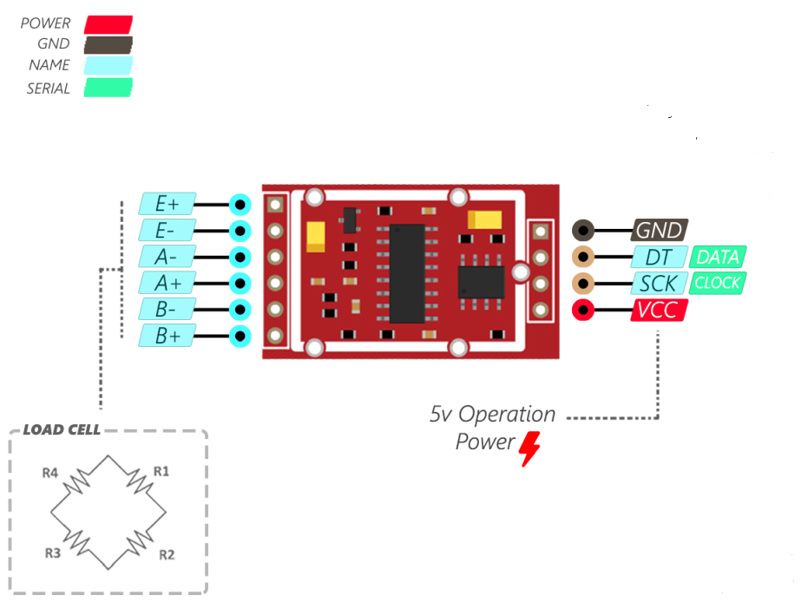
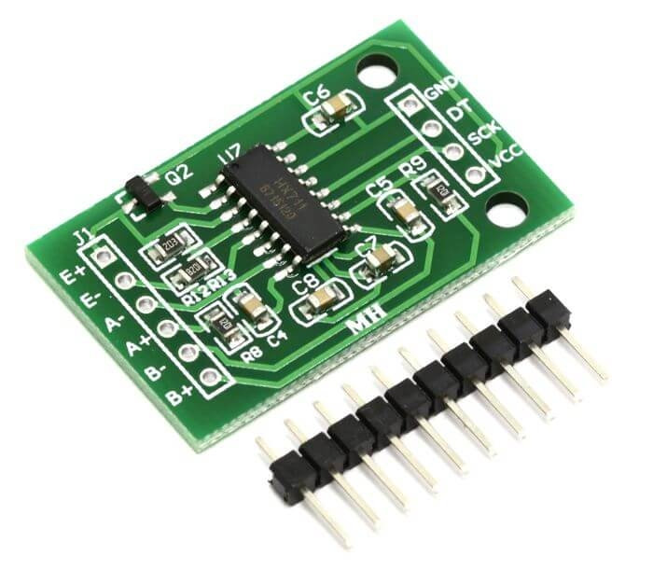
HX711 Module

Slide 19
Technique -HX711 Module
This module is designed for weighing scales and industrial control applications to interface directly with a bridge sensor.
Channel A or B reads sensor outputs through a input mux.
Then the low level voltage signals are amplified using PGA(Programmable Gain Amplifier)
Three selectable programmable gains are available.(Ex:128,64,32).
Then amplified signal will be converted from analog to digital format by using ADC.
Store the converted value in 24 bits binary format.
By providing 25 to 27 clock pulses to PD_SCK pin,the 24 bits data value can be retrieved bit by bit from the DOUT pin.

Slide 20
Specifications-HX711 Module
Maximum voltage-5.5V
Maximum current-<1.5mA
Link to refer Speciation Data Sheet-
Microsoft Word - hx71_english.doc (sparkfun.com)

Slide 21
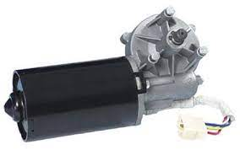
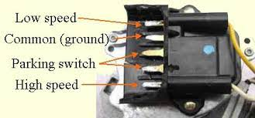
WD1160 DC motor

Slide 22
Technique-WD1160 DC Motor
This is a vehicle viper motor.
It has a considerable amount of torque to rotate the massaging metal plate.
This motor axle is coupled with center of the massaging plate by using a gear wheel.
The motor will turn off if the load exceeds 15 kilograms.If the load is below than 15 kilograms the motor will work in a normal manner.

Slide 23
Specifications-WD1160 DC Motor
Maximum voltage -12V
Maximum current-5.6A
Torque-5.2Nm
Link to refer Speciation Data Sheet - www.china-electricmotor.com/pdf/wm.pdf

Slide 24
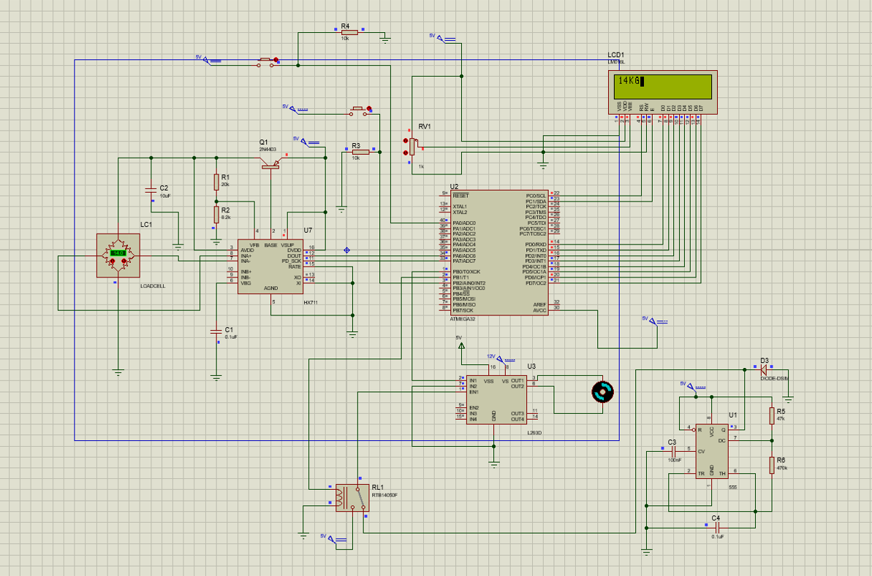
Circuit diagram

Slide 25
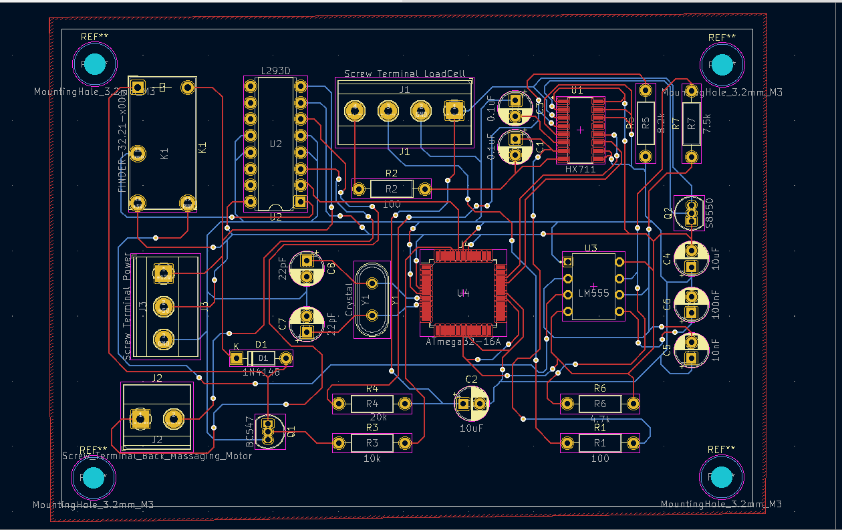
PCB

Slide 26
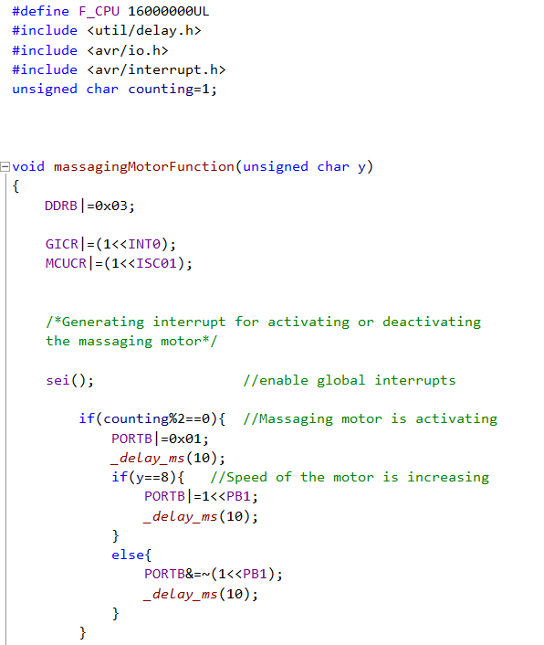
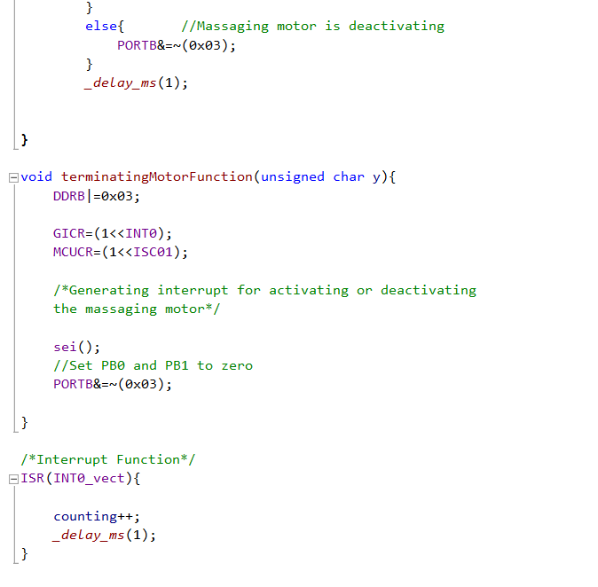
Compiled code - DC Motor (Massaging Function)

Slide 27
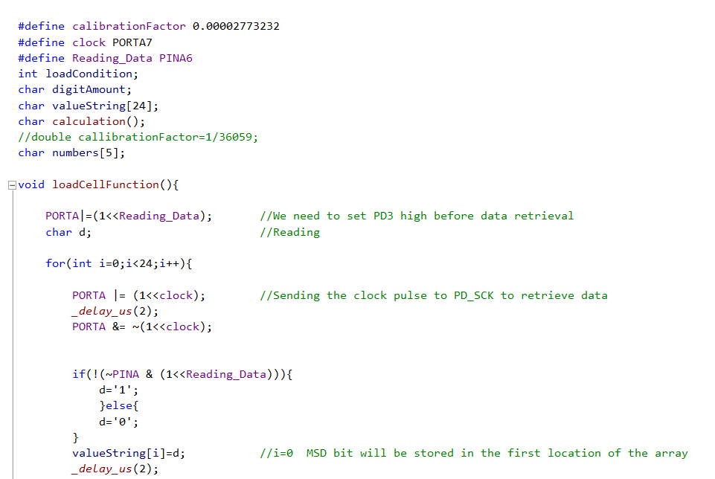
Compiled code-Load Cell

Slide 28
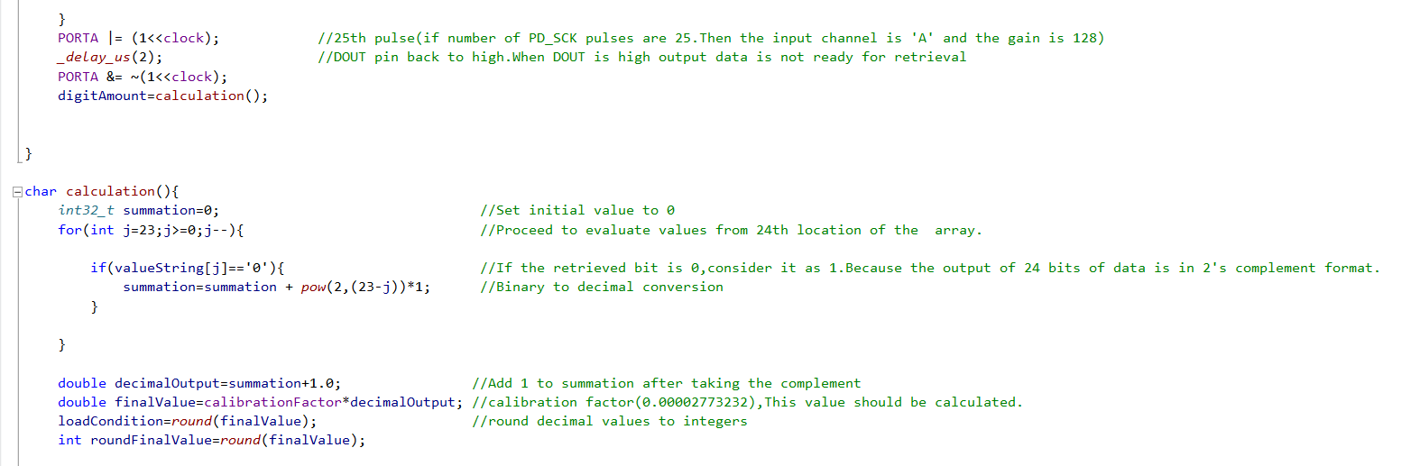
Compiled code-Load Cell Cont.

Slide 29

Compiled code-Load Cell Cont.

Slide 30
K.V.Siromin
204204N
Responsibilities
LM35 Temperature sensor - Two temperature sensors are used to get the surface temperatures of the peltier device.
Peltier Device - This is used to cool or heat the system according to user preference.
Blower fan - This is used to blow the air through the horse pipe.
Cooling fan - This fan is used to remove the temperature from system to the outside

Slide 31
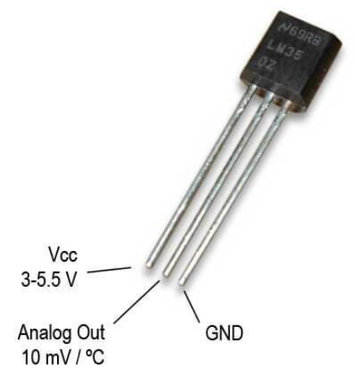
LM35 Temperature sensor

Slide 32
Technique -LM35
LM35 has voltage output pin. It outputs voltage according to the temperature.
Pin that connected with voltage output gets that voltage value.
Then ADC conversion happens and gets relevant temperature value according to the voltage.
This gives 10 mV increment for every 1C temperature increment.
Two LM35 sensors are used to measure the temperatures of the both sides of the peltier device.

Slide 33
LM35 Temperature sensor Cont.
Maximum voltage - 30 V
Maximum current - 60 microA
Link to refer Speciation Data Sheet:
LM35 Precision Centigrade Temperature Sensors (Rev. G) (components101.com)

Slide 34
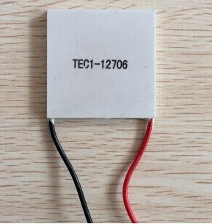
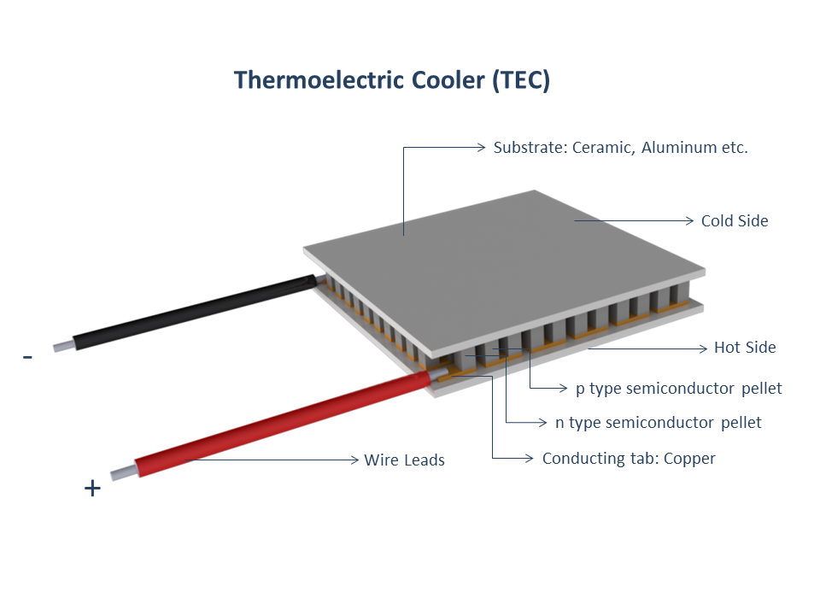
TEC1-12706 Peltier Module.

Slide 35
Technique -Peltier Device
It is based on peltier effect.
Modern peltier devices are built using semiconductors.
When we pass the current through peltier device one side will be heated and other side will be cooled.
Also, when we change the direction of the current through this, previously heated side will be cooled and cooled side will be heated.
This, method is used to cool or heat the system according to user preference.

Slide 36
TEC1-12706 Peltier Module cont.
Maximum voltage - 16.4 V
Maximum current - 6.4A
Link to refer Speciation Data Sheet:
TEC1-12706 (peltiermodules.com)

Slide 37
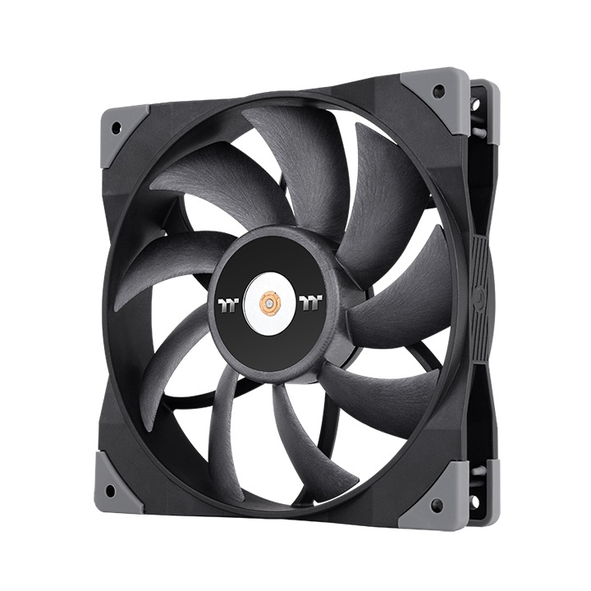
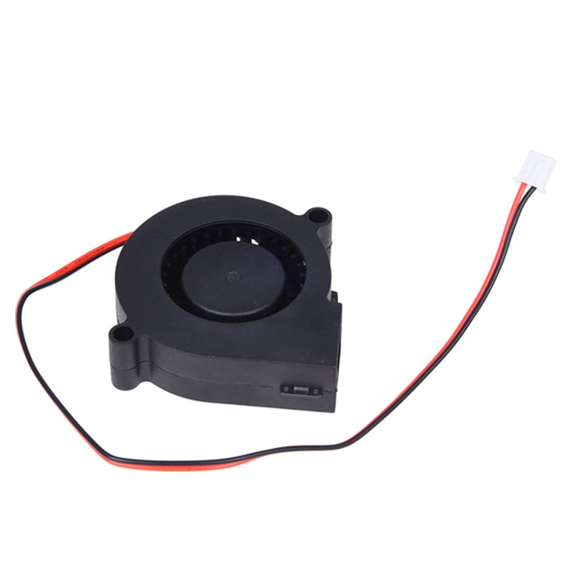
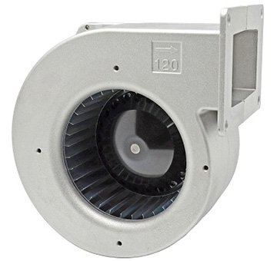
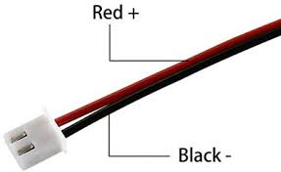
Blower fan & Cooling fan.

Slide 38
Technique -Fans
Blower fan is a centrifugal type fan.
Centrifugal type fans are mechanical device for moving air in a direction at an angle to the incoming fluid.
Cooling fan is an axial type fan.

Slide 39
Blower fan & Cooling fan cont.
Blower fan
Maximum voltage - 13.8V
Maximum current - 230 mA
Link to refer Speciation Data Sheet - 3205325.pdf (farnell.com)
Cooling fan
Maximum voltage - 13.8 V
Maximum current - 64mA
Link to refer Speciation Data Sheet - 2841716.pdf (farnell.com)

Slide 40
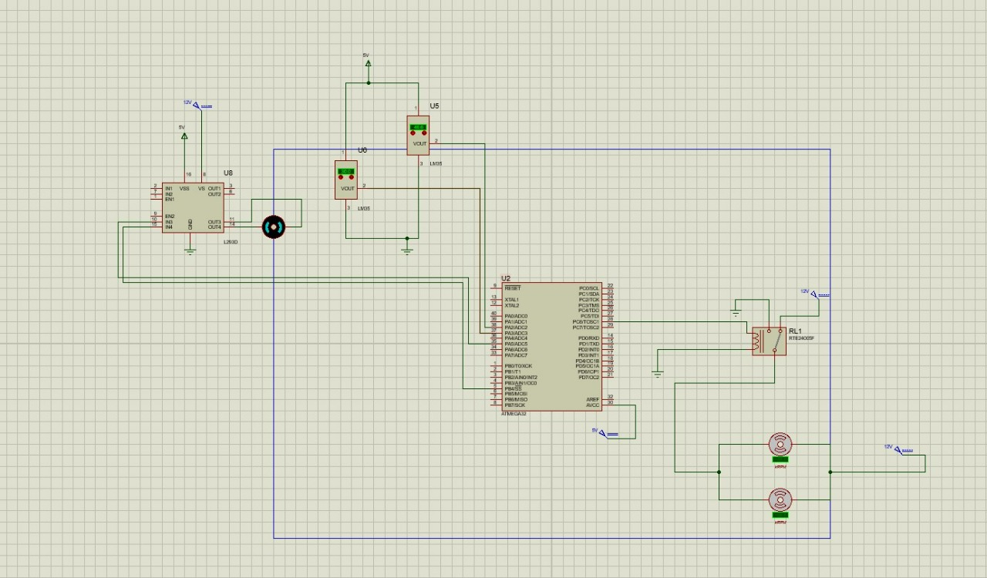
Circuit diagram

Slide 41
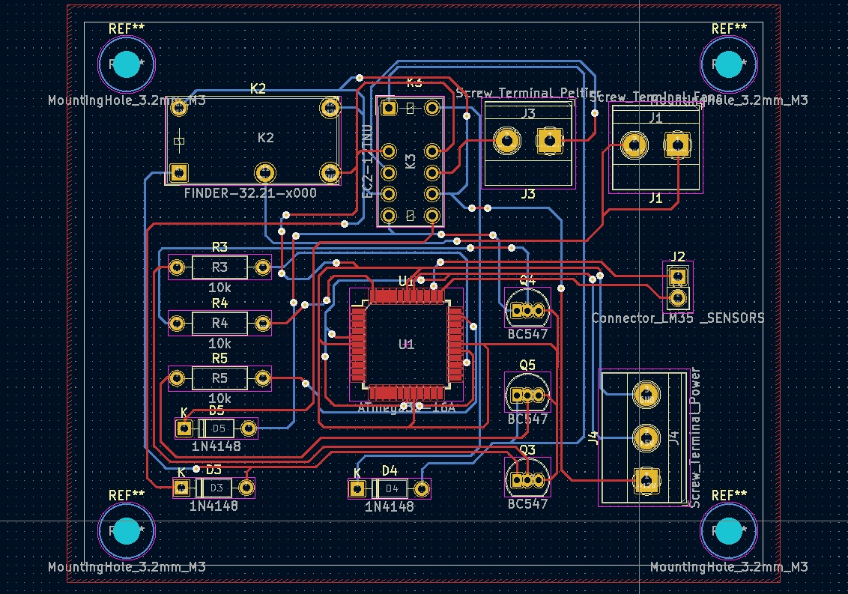
PCB

Slide 42
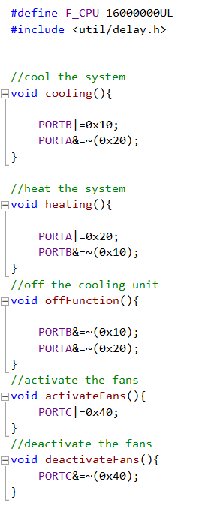
Compiled code - Peltier Device and Fans

Slide 43
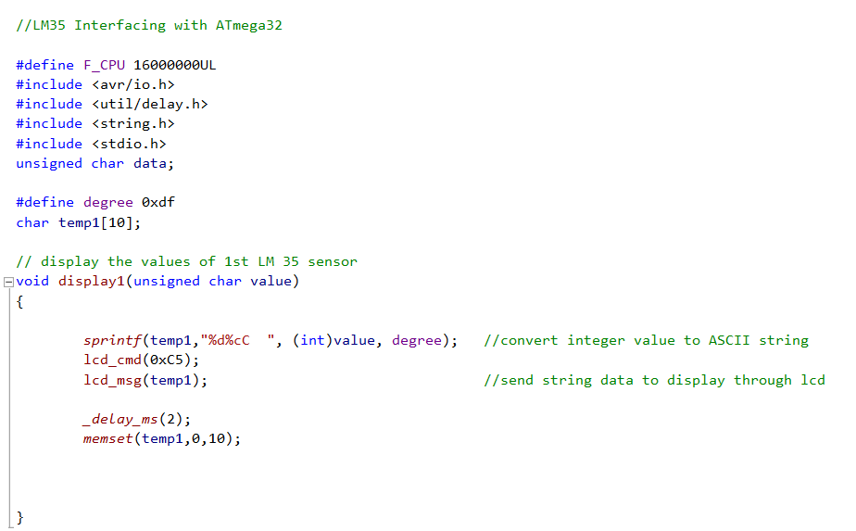
Compiled code - Temperature Sensor.

Slide 44
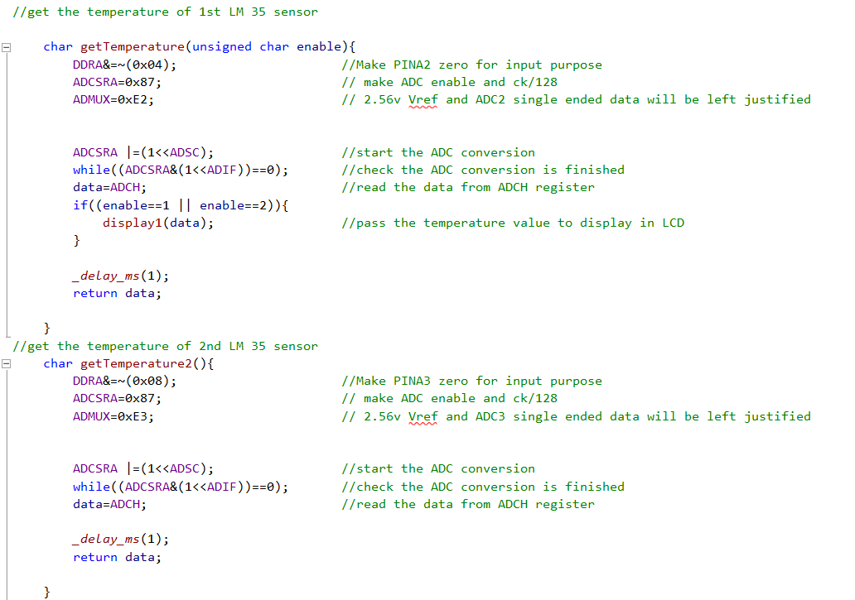
Compiled code - Temperature Sensor Cont.

Slide 45
K.A.P.S. Priyadarshana
204167C
Responsibilities
Power Shutter Motor(MR573877)- This gear motor is used to move the foot rest
Gear DC motor(FIT0492-B)- This gear motor is used to rotate the wooden massager in foot rest
Power supply Unit & Battery pack - This unit is used to give input power for microcontroller & other component

Slide 46
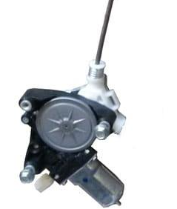
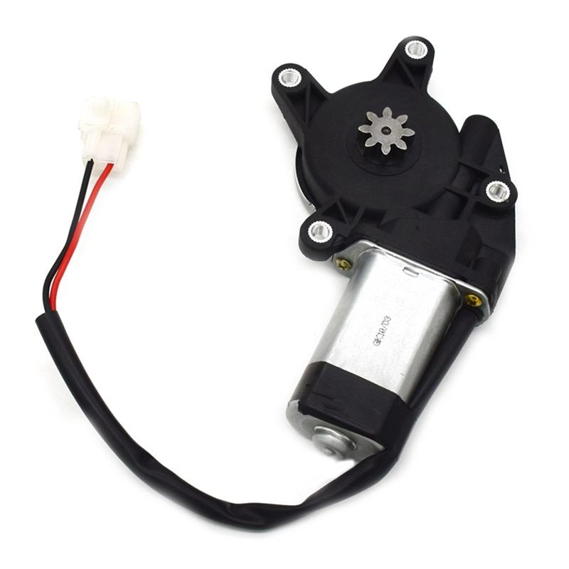
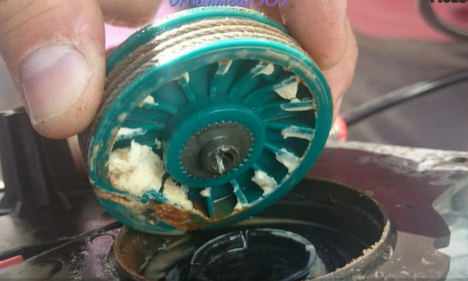
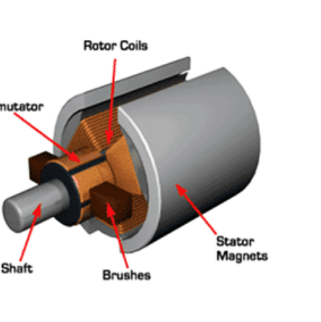
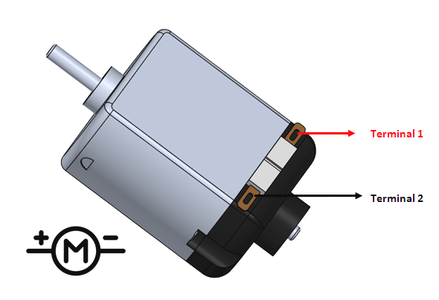
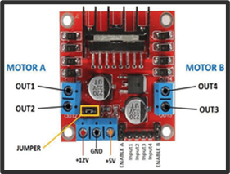
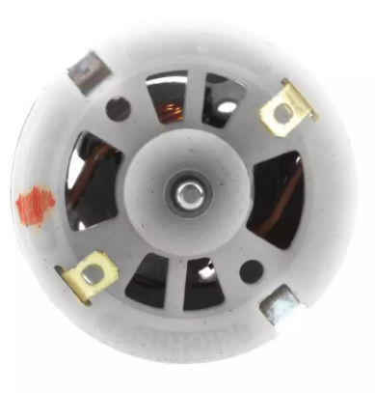
Power Shutter motor(Window Regulator Motor)
MR573877
Gear DC motor(FIT0492-B)
l293d Motor Driver

Slide 47
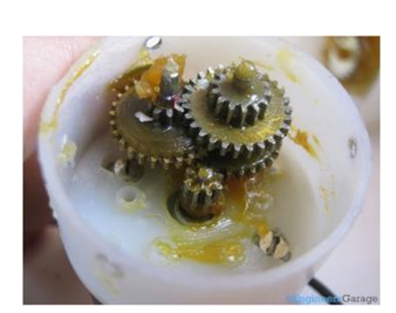
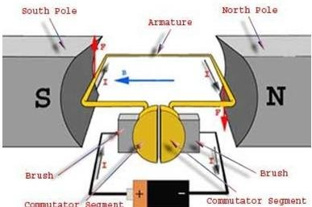
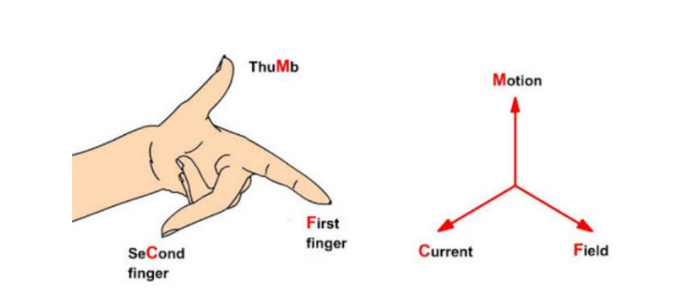
Power Shutter motor & DC motor: technique
The DC motor's primary working concept is that whenever a current carrying conductor enters the magnetic field, it is subjected to a mechanical force.
The magnitude of Fleming's left-hand rule determines the force's direction.
If we stretch the first finger, second finger and thumb of our left hand to be perpendicular to each other, and first finger represents the direction of the magnetic field, the second finger represents the direction of the current, then the thumb represents the direction of the force of current carrying conductor.
The addition of a gear head to a motor reduces the speed while increasing the torque output

Slide 48
Power shutter motor (MR573877) :specification
Dc motor (FIT0492-B): specification
Maximum voltage:12V
Maximum current:15A
Rated Torque:13Nm
Maximum voltage:12V
Maximum current:1.1A
Rated Torque: 4.5 kg.cm
Link to refer Speciation:
Amazon.com: Greartisan DC 12V 100RPM Gear Motor High Torque Electric Micro Speed Reduction Geared Motor Centric Output Shaft 37mm Diameter Gearbox : Automotive

Slide 49
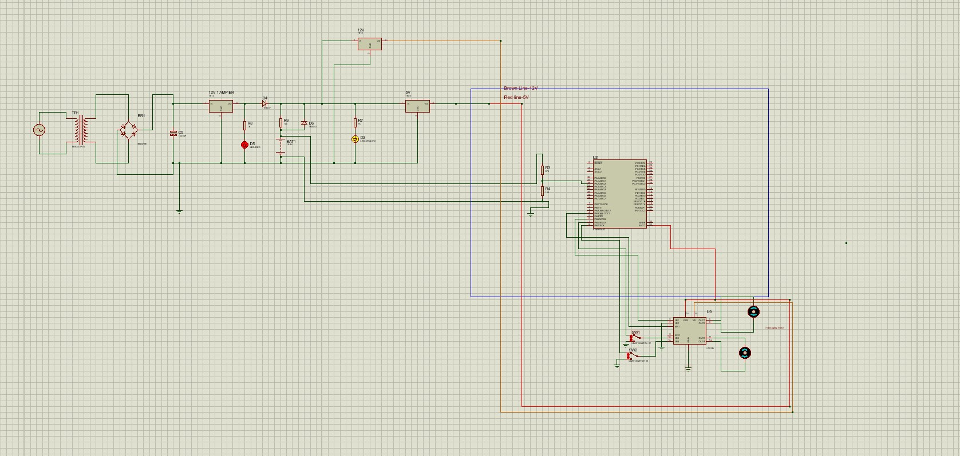
Power Shutter motor & DC motor: Circuit Diagram
Foot massaging motor
L293d Motor Drive
Foot rest moving motor

Slide 50
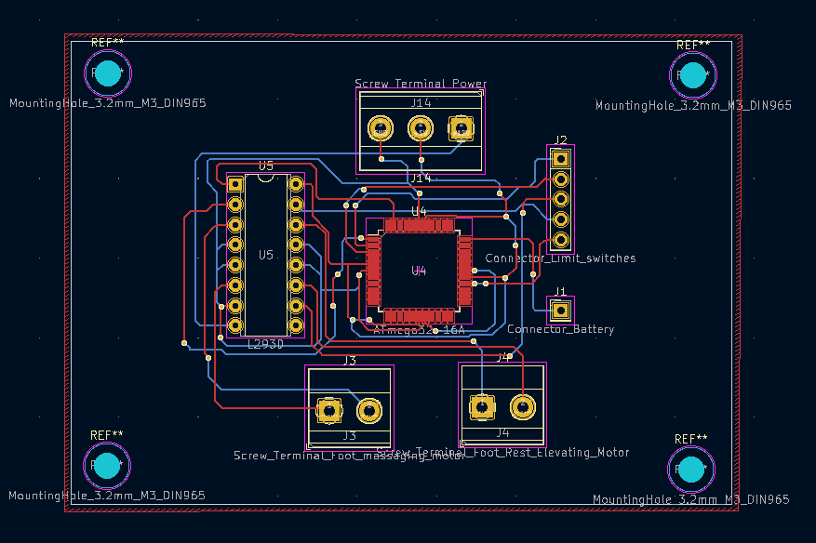
Power Shutter motor & DC motor: PCB layout

Slide 51
Power supply & Battery pack: Technique
Power supply unit consists of a step-down transformer, bridge rectifier, regulator IC L7812, regulator IC L7805, capacitor of 1000µF and resistors 30Ω,100Ω & 1KΩ and two LEDs and 14.8 V battery pack.
First the transformer steps down the input signal of 230V AC to 18V AC signal. In this step principle of electromagnetic induction is used.
First the rectifier circuit (which consists of 1N4007 diodes) converts the bidirectional AC signal into a unidirectional DC signal by eliminating the one side of the AC signal.
After rectification the DC signal consists of AC ripples and voltage fluctuations are fed into capacitor C5 which removes most of the AC ripples from the signal and smooth current.
Then the filtered signal is fed into voltage regulation IC which receives the unregulated DC voltage at its input and provides regulated 12V DC at its output.
The 12V DC signal is again filtered and fed into the IC 7805 which takes in the input signal and provides regulated 5V DC at its output .

Slide 52
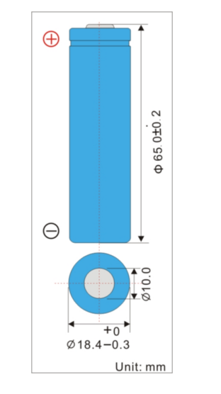
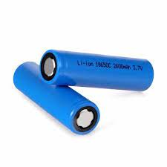
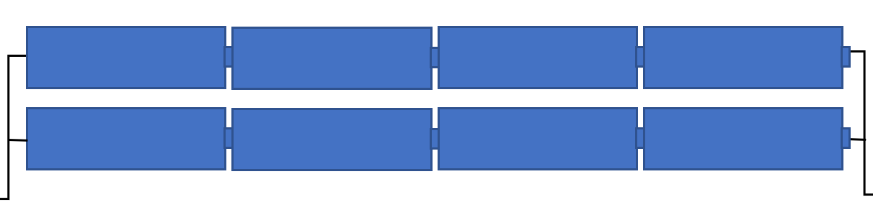
Lithium-ion Battery( LIR18650):Specification
Nominal Voltage :3.7V
Discharge Cut-off Voltage :3.0V
Nominal Capacity :2600mAh
Standard Charge Current :0.52A
Standard Discharge Current:0.52A
The battery pack is made up of two pair of four series batteries running parallel each other to get 14.8V

Slide 53
Power supply & Battery pack:Circuit diagram

Slide 54
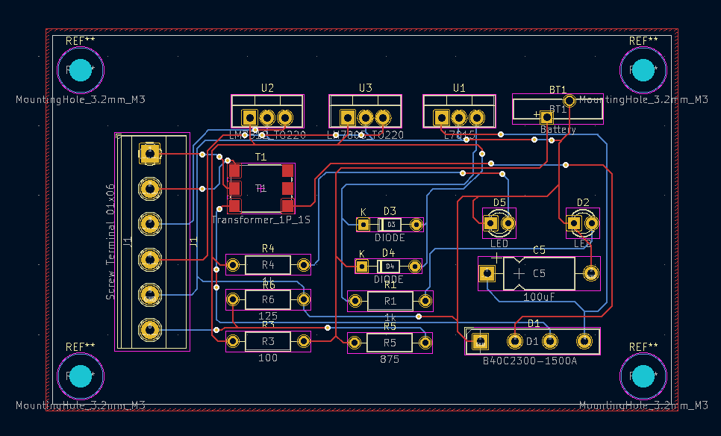
Power supply & Battery pack:PCB Design

Slide 55
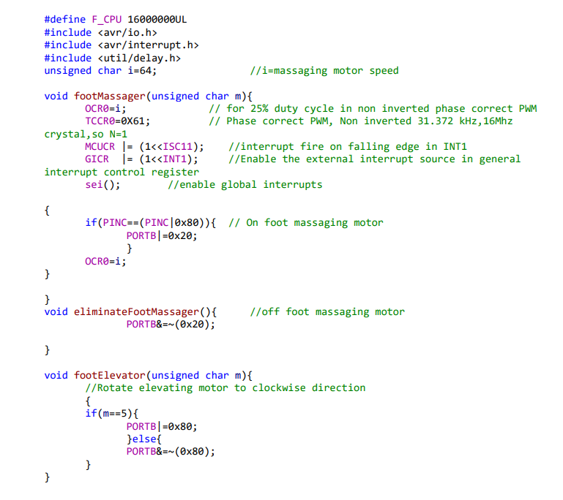
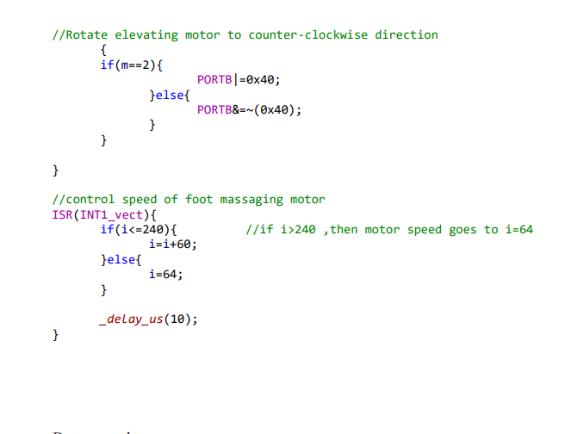
Compiled code - DC Motors (Footrest moving function and massaging function)

Slide 56
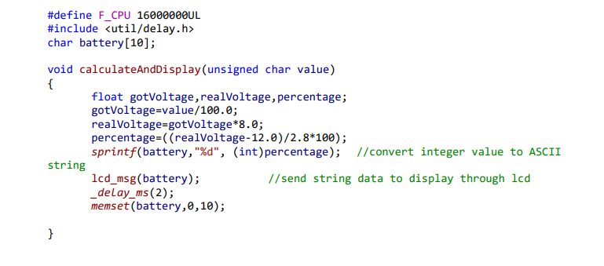

Compiled Code - Battery pack

Slide 57
B.L.P.Sankalpana
204190N
Responsibilities
HC-SR04 Ultrasonic sensor - we use the ultrasonic sensor to determine whether or not a user is sitting in the chair. If the user is not seated, we can reduce our system's power consumption by turning off some functions.
4X4 Keypad - We collect user inputs using a 4x4 keypad( give commands to control the footrest, footrest vibrate speed, functioning of cooling and heating system, lumbar support, massaging function)

Slide 58





Ultrasonic Sensor(HC SR04)
Front view
Back view

Slide 59
Technique -HC SR04
This sensor is based on sonar principles.
First we should send a trigger pulse of at least 10 us to the Trigger pin.
Then sensor will produce an ultrasound with a frequency of 40 kHz (8 pulses).
Next makes the echo pin high. Starts the timer
Then the echo pin stays high until the echo sound is not returned.
Read the Timer count as soon as the falling edge is captured at the Echo pin.
This is the time it takes the wave to travel to the object and back
We can calculate the distance using the formula distance= speed * time. (speed = 343 m/s, time = the measured time/2)

Slide 60

Specifications-HC SR04
Maximum voltage - 5V
Maximum current - 15 mA
Dimension - 45mm x 20mm x 15mm
Ranging Distance - 2 cm – 400 cm
Link to refer Speciation Data Sheet - https://cdn.sparkfun.com/datasheets/Sensors/Proximity/HCSR04.pdf

Slide 61

Circuit Diagram- HC SR04

Slide 62


4x4 Keypad

Slide 63
Technique -4X4 Keypad
The structure of the keypad is a matrix. there are 4 columns and 4 rows.
There is no connection between rows and columns if we do not press any keys.
When we press a key, the specific column and row of that key will be contacted.
First, the microcontroller grounds all rows by providing a value of 0. And start examining the column value.
No key has been pressed if all columns read '1'. If any of the four columns show a '0,' it means a key has been pressed.
To identify the pressed key. First, the microcontroller grounds the first row, then checks each column. If all of the columns are '1', the pressed key is not from the first row.
Following that, ground the second row and read all of the columns. This procedure will be repeated until a column value is recognized as '0.'

Slide 64



4X4 keypad
(1)
(2)
(3)

Slide 65
Specifications-4x4 keypad
Maximum Voltage across each segment or button - 24V
Maximum Current through each segment or button - 30mA
Maximum operating temperature - 0°C to + 50°C
Link to refer Speciation Data Sheet -
4x4 Matrix Membrane Keypad (#27899) (sparkfun.com)

Slide 66

Circuit Diagram- 4X4 keypad

Slide 67

PCB

Slide 68

Compiled code- HC-SR04

Slide 69

Compiled code- HC-SR04 Cont.

Slide 70

Compiled code- HC-SR04 cont.

Slide 71

Compiled code- HC-SR04 cont.

Slide 72

Compiled code- HC-SR04 cont.

Slide 73



Compiled Code - 4x4 Keypad

Slide 74
S.A.R.Nethmini
204137K
Responsibilities
LCD Display(16x2) - We have to display the battery percentage and the surface temperature of the peltier device.
PCF8574A-Remote 8 bit I/O expander for I2C-To connect LCD with Microcontroller
Stepper Motor (SY42STH38 - 1684A) - To move the lumbar support forward and backward.

Slide 75


LCD Display

Slide 76

16X2 LCD Display-
16 number of characters per line and 2 lines.
4 bit mode

Slide 77

Internal structure of LCD

Slide 78
LCD Display cont.
Maximum voltage: 5V
Maximum current:1.5 mA
Link to refer Speciation Data Sheet:
https://components101.com/sites/default/files/component_datasheet/16x2%20LCD%20Datasheet.pdf

Slide 79


PCF8574A-Remote 8 bit I/O expander for I2C

Slide 80

Takes 2 pins from the microcontroller.
PC0-SCL (serial clock)-carries the clock signal.
PC1-SDA (serial data) -transfers the data that takes place through the pin.
Master device- Atmega
Slave device- LCD

Slide 81

Internal Structure of PCF8574A-Remote 8 bit I/O expander for I2C

Slide 82
PCF8574A-Remote 8 bit I/O expander for I2C cont.
Maximum voltage:6V
Maximum current:25 mA
Link to refer Speciation Data Sheet:
https://pdf1.alldatasheet.com/datasheet-pdf/view/83871/TI/PCF8574A.html

Slide 83



Stepper motor

Slide 84

Ability to control the position of the rotor
Bipolar stepper
-has more torque
-doesn't have the center tap wire
Motor driver L293D
-to drive the stepper motor.

Slide 85
Stepper Motor cont.
Maximum voltage:12V
Maximum current:1.7A
Torque:3.7 kg-cm
Link to refer Speciation:
https://www.pololu.com/product/2267

Slide 86

Circuit diagram

Slide 87

PCB Design

Slide 88



Compiled code- LCD Display

Slide 89

Compiled code - I2C

Slide 90




Compiled code - Stepper Motor

Slide 91
Thank You
Q & A

